Slide 1
Part 3: Application Enhancement & Automation
Student Number: ST10440112
Module: PROG6212
November 2025

Slide 2
Agenda
1. Part 2 to Part 3 Changes Overview
2. Feedback Implementation Summary
3. Lecturer View - Claim Submission Automation
4. Coordinator & Manager View - Verification/Approval Workflow
5. HR View - User Management & Reporting
6. Session Management & Access Control
7. Document Encryption Security
8. Error Handling Improvements
9. Live Demo / Key Screenshots
10. Conclusion
11. Links

Slide 3
Part 2 to Part 3 - What Changed?
Part 2 Features (Existing)
- Basic claim submission
- Simple approval workflow
- Document uploads (no encryption)
- Limited error handling
Part 3 Enhancements (New)
- ASP.NET Core Identity authentication
- HR role with user management
- Automated hourly rate (HR-managed)
- Auto-calculation (Hours × Rate)
- Two-stage approval workflow (Coordinator → Manager)
- Invoice & report generation
- Session management & access control
- AES-256 document encryption
- Circuit breaker error handling
- Comprehensive validation

Slide 4
Feedback - Two-Stage Approval Workflow
Problem
Needed better separation between verification and approval stages.
Solution Implemented
Pending → Coordinator Verifies → Verified → Manager Approves → Approved
Key Code (CoordinatorController.cs)
var pendingClaims = await _context.Claims
.Where(c => c.ClaimStatus == "Pending")
.Include(c => c.Lecturer)
.ToListAsync();
Key Code (ManagerController.cs)
// Manager only sees Verified claims
var verifiedClaims = await _context.Claims
.Where(c => c.ClaimStatus == "Verified")
.Include(c => c.Lecturer)
.ToListAsync();

Slide 5
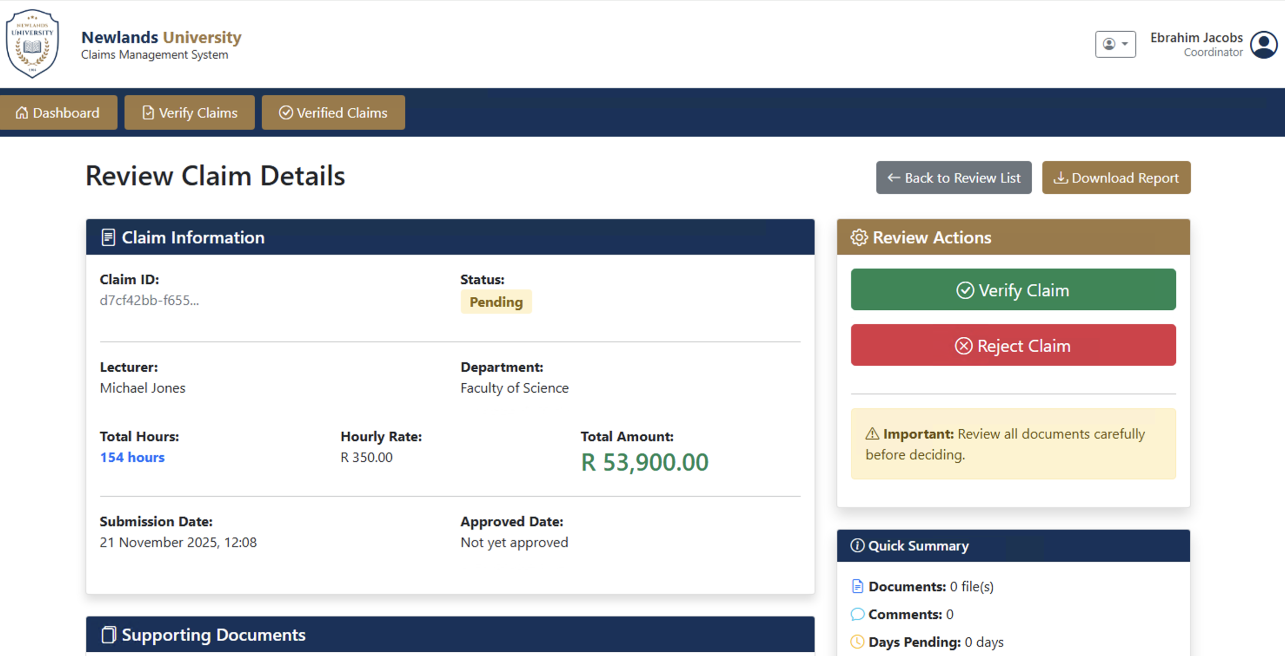
Feedback Two Stage Screenshot

Slide 6
Part 3 - Lecturer Claim Submission Automation
Problem
- Hourly rate was manually entered by lecturer (could be tampered)
Solution:
Auto-Fill Hourly Rate from HR Database
JavaScript Auto-Calculation (Create.cshtml)
$('#TotalHours').on('input', function() {
var hours = parseFloat($(this).val()) || 0;
var rate = parseFloat($('#HourlyRate').val()) || 0;
var total = hours * rate;
$('#calculatedAmount').text('R ' + total.toFixed(2));
});
Key Code (ClaimsController.cs)
var lecturer = await _context.Lecturers
.FirstOrDefaultAsync(l => l.Email == userEmail);
var model = new ClaimSubmissionViewModel
{
HourlyRate = lecturer.HourlyRate, // Auto-filled, read-only
TotalHours = 0
};

Slide 7
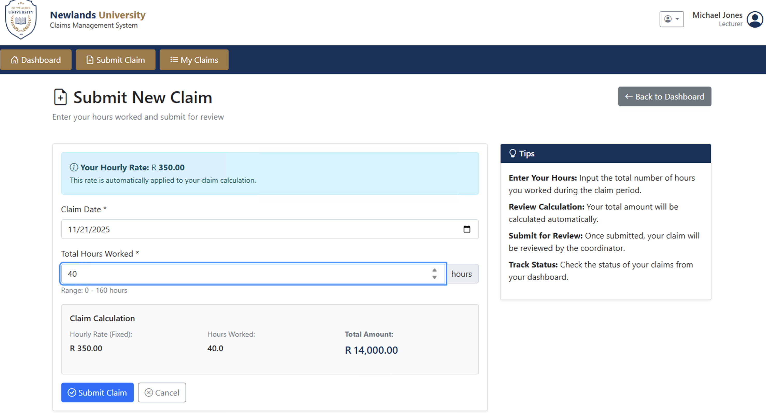
Part 3 Hour Automation Screenshot 1

Slide 8
Feedback - Document Encryption (AES-256)
Problem
- Uploaded documents stored without encryption
Solution:
Military-Grade AES-256 Encryption
Secure Download (SecureFileController.cs)
[Authorize]
public async Task<IActionResult> Download(Guid documentId)
{
var document = await _context.Documents.FindAsync(documentId);
// Authorization check
if (!await UserCanAccessDocument(document))
return Forbid();
// Decrypt file before serving
var decrypted = _encryptionService.DecryptFile(document.Content);
return File(decrypted, document.ContentType, document.FileName);
}
Key Code (FileEncryptionService.cs)
public byte[] EncryptFile(byte[] fileContent)
{
using (Aes aes = Aes.Create())
{
aes.Key = _encryptionKey;
aes.IV = _iv;
aes.Mode = CipherMode.CBC;
aes.Padding = PaddingMode.PKCS7;
using (var encryptor = aes.CreateEncryptor())
{
return encryptor.TransformFinalBlock(
fileContent, 0, fileContent.Length);
}
}
}

Slide 9
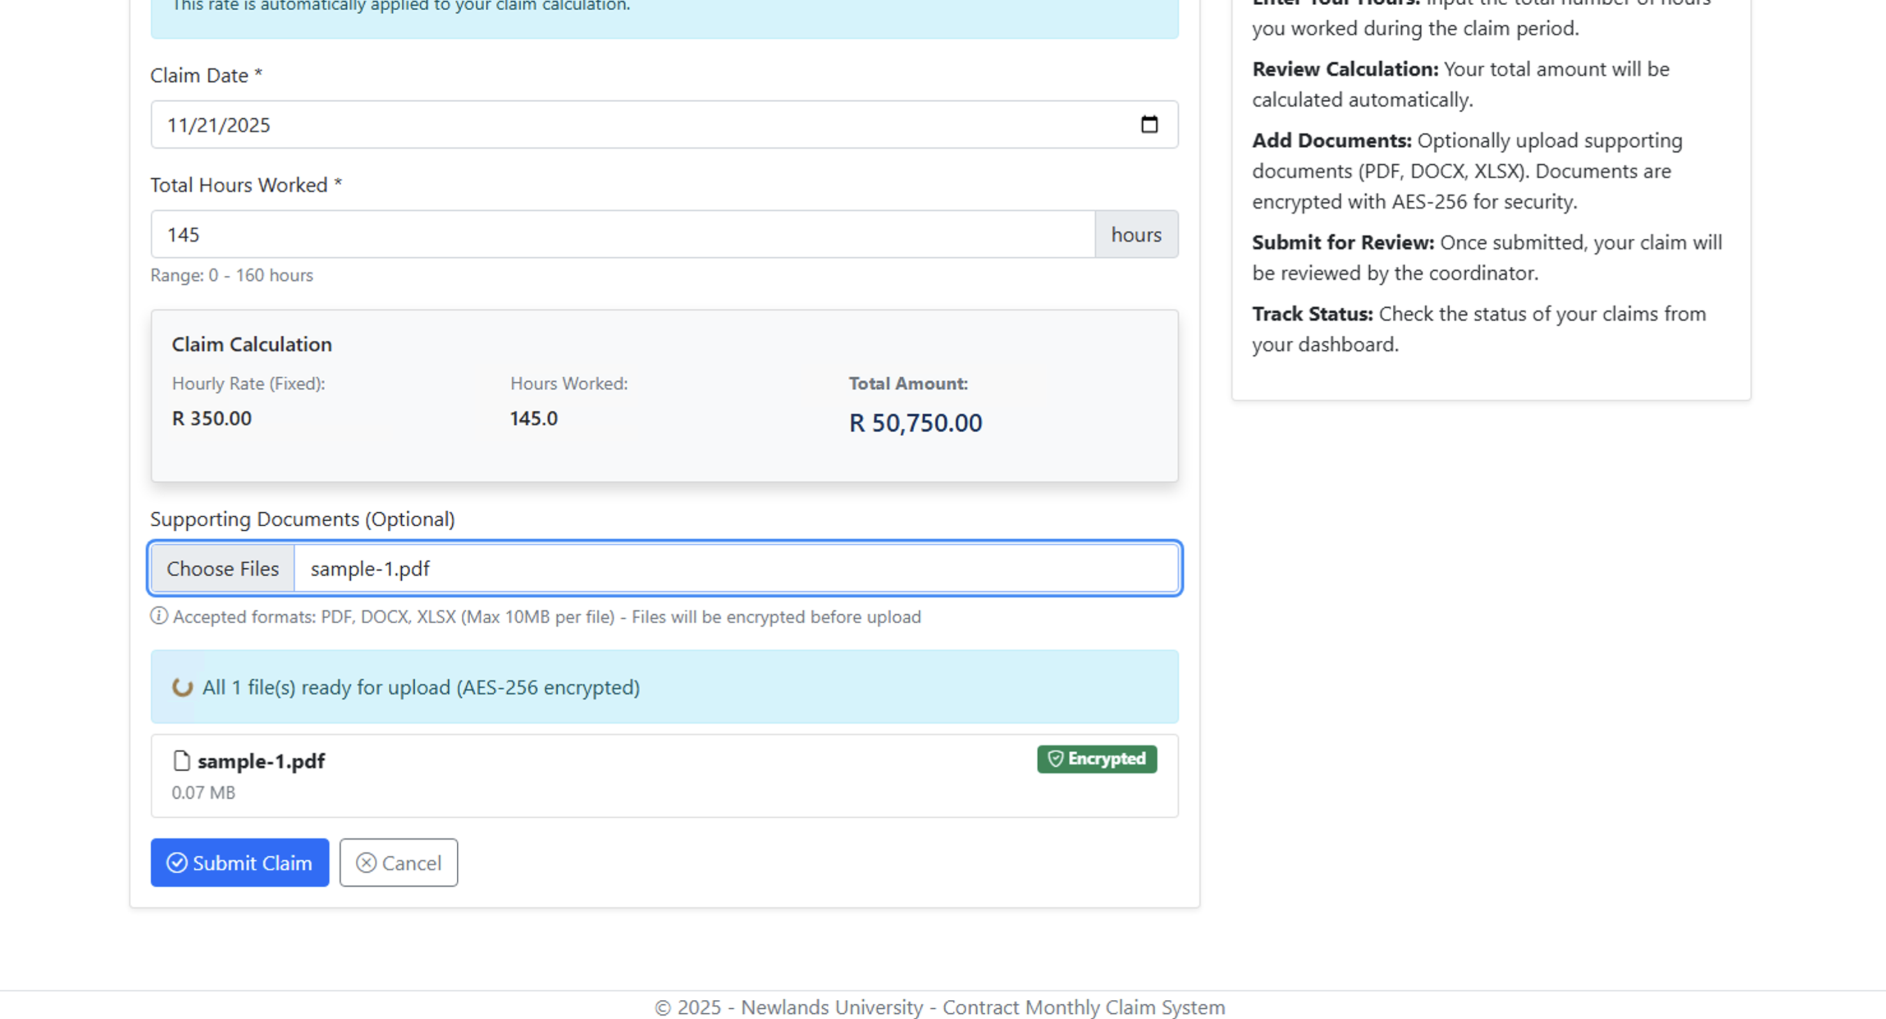
Feedback - Document Encryption (AES-256)

Slide 10
Feedback – Error handling. (death loop)
Problem
- Application entered and infinite redirect loop when encountering errors
Solution:
Implement a circuit breaker pattern
Key Code (ClaimsController.cs)
// Track error count in session
var errorCount = HttpContext.Session.GetInt32("ErrorCount") ?? 0;
if (errorCount >= 3)
{
// Circuit breaker triggered - break the loop
HttpContext.Session.SetInt32("ErrorCount", 0);
TempData["ErrorMessage"] = "Multiple errors occurred. Please try again.";
return RedirectToAction("Index", "Home");
}
}
Continues >>>>>>>>>>>>>>>>
try
{
// Normal operation
await ProcessClaim();
HttpContext.Session.SetInt32("ErrorCount", 0); // Reset on success
}
catch (Exception ex)
{
HttpContext.Session.SetInt32("ErrorCount", errorCount + 1);
_logger.LogError(ex, "Error processing claim");
return RedirectToAction("Error", "Error");
}

Slide 11
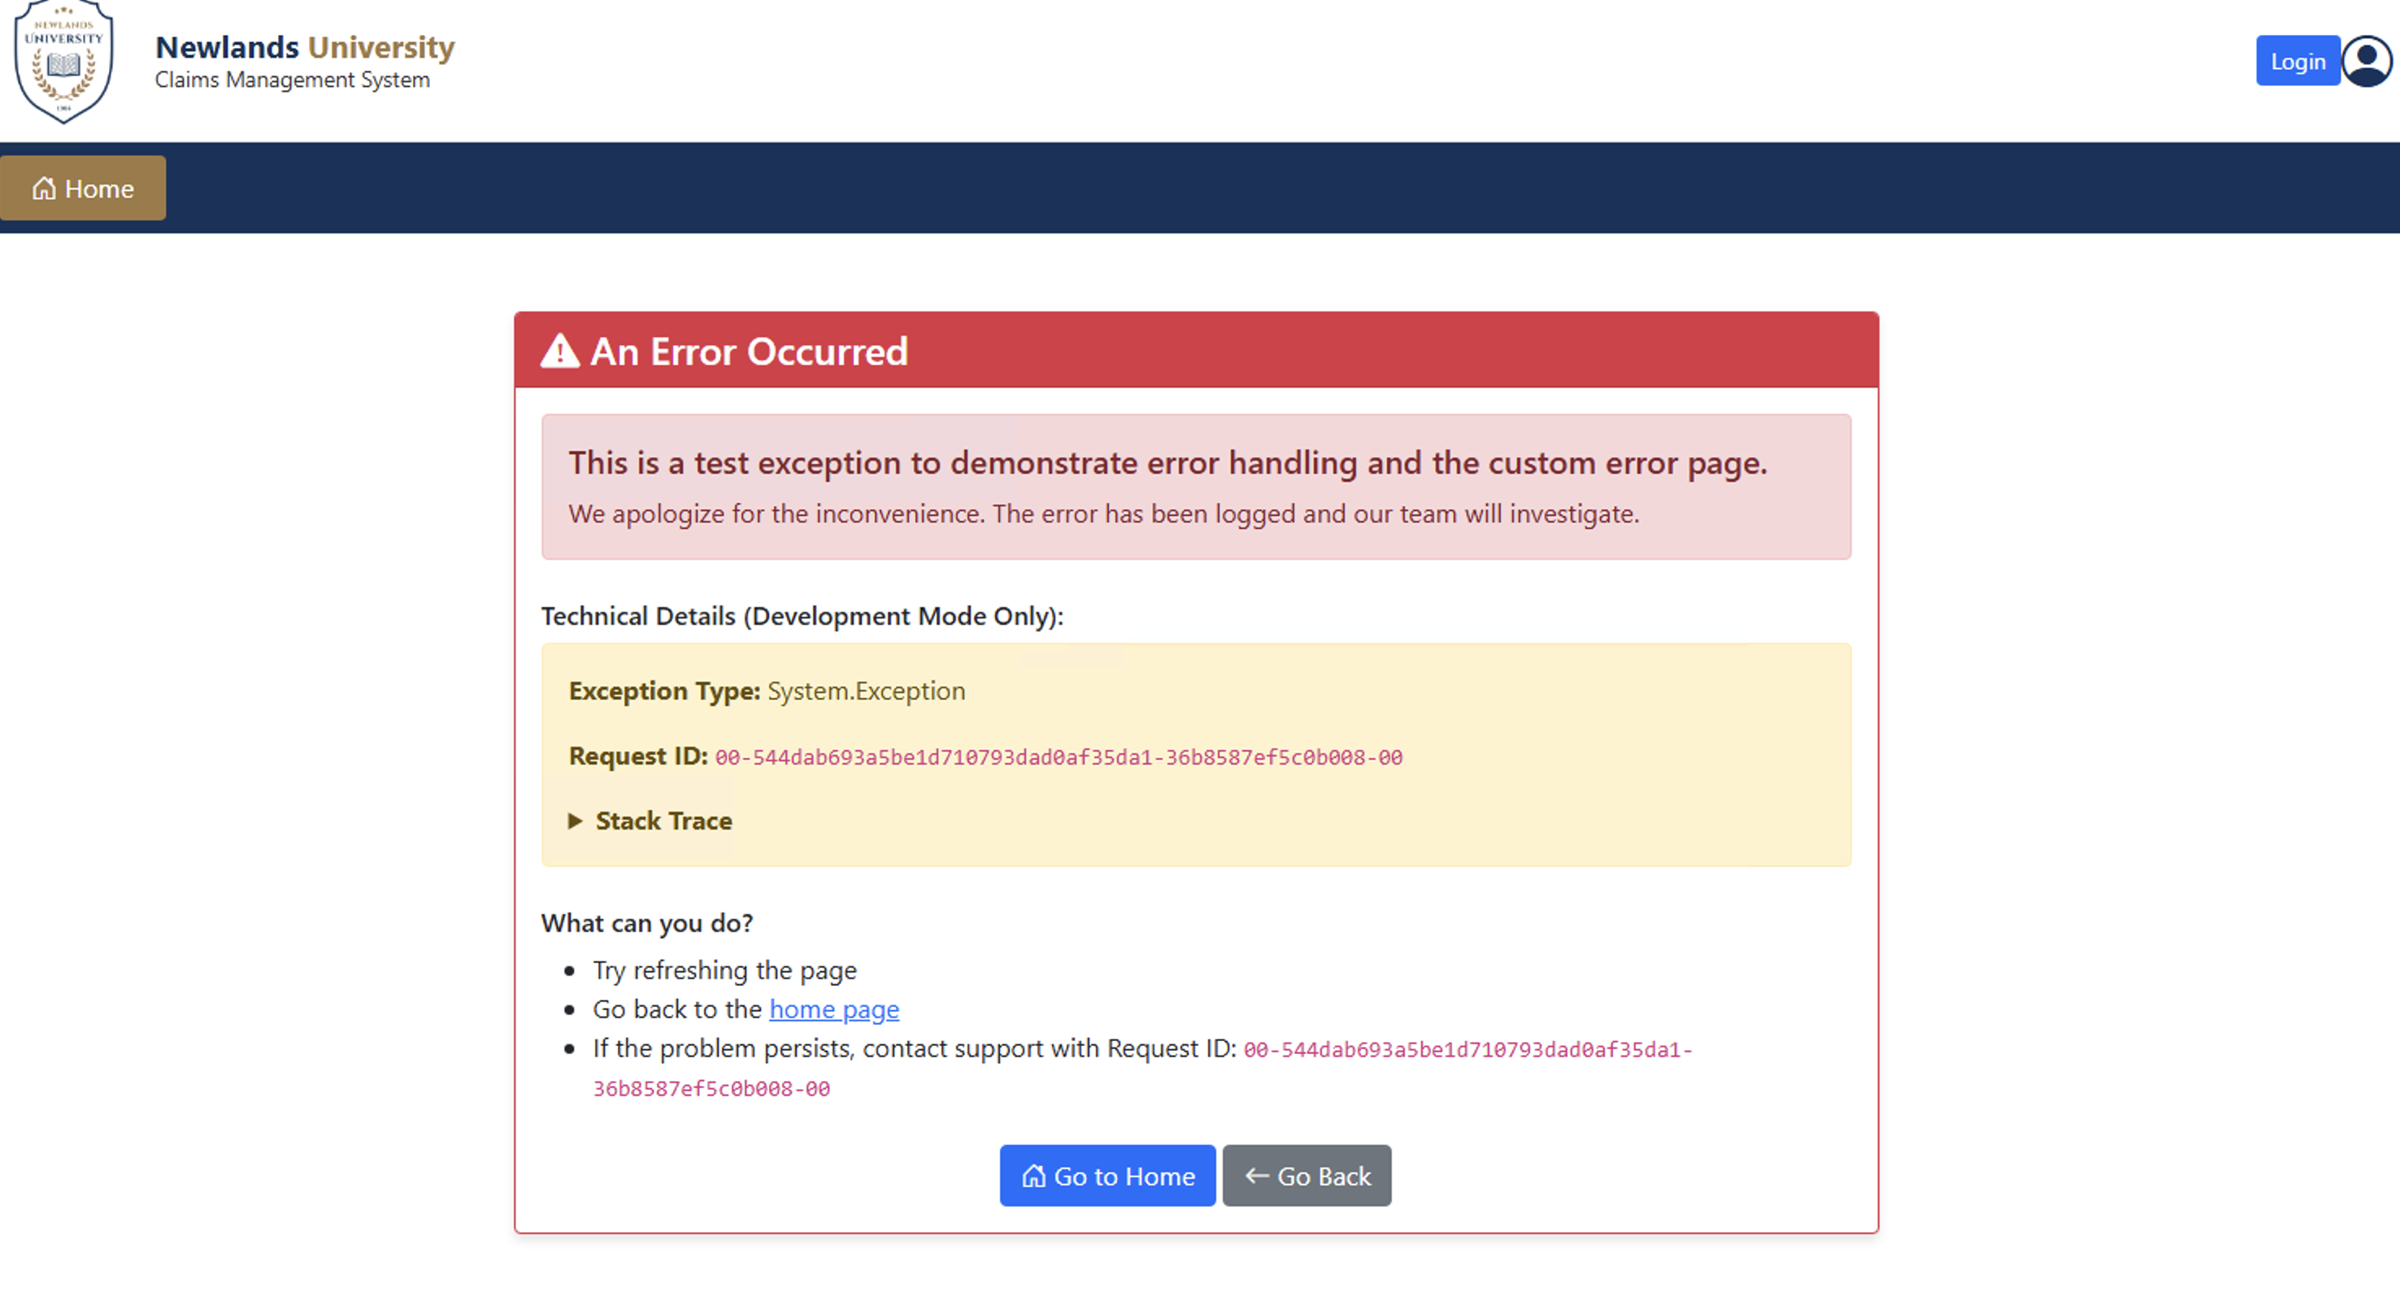
Feedback - Document Encryption (AES-256)

Slide 12
Part 3 – HR Features (User Management)
Features Implemented
- Create new users (all roles)
- Manage existing users
- Bulk import lecturers via CSV
- Update lecturer hourly rates
- No self-registration (HR creates accounts)
Key Code (HRController.cs)
[HttpPost]
public async Task<IActionResult> CreateUser(CreateUserViewModel model)
{
var user = new AppUser
{
UserName = model.Email.Split('@')[0],
Email = model.Email,
FullName = model.FullName,
Role = model.Role
};
Continues >>>>>>>>>>>>>>>>
var result = await _userManager.CreateAsync(user, model.Password);
if (result.Succeeded)
{
await _userManager.AddToRoleAsync(user, model.Role);
// If Lecturer, also create Lecturer profile
if (model.Role == "Lecturer")
{
var lecturer = new Lecturer
{
Name = model.FullName,
Email = model.Email,
Department = model.Department,
HourlyRate = model.HourlyRate
};
_context.Lecturers.Add(lecturer);
await _context.SaveChangesAsync();
}
}
}

Slide 13
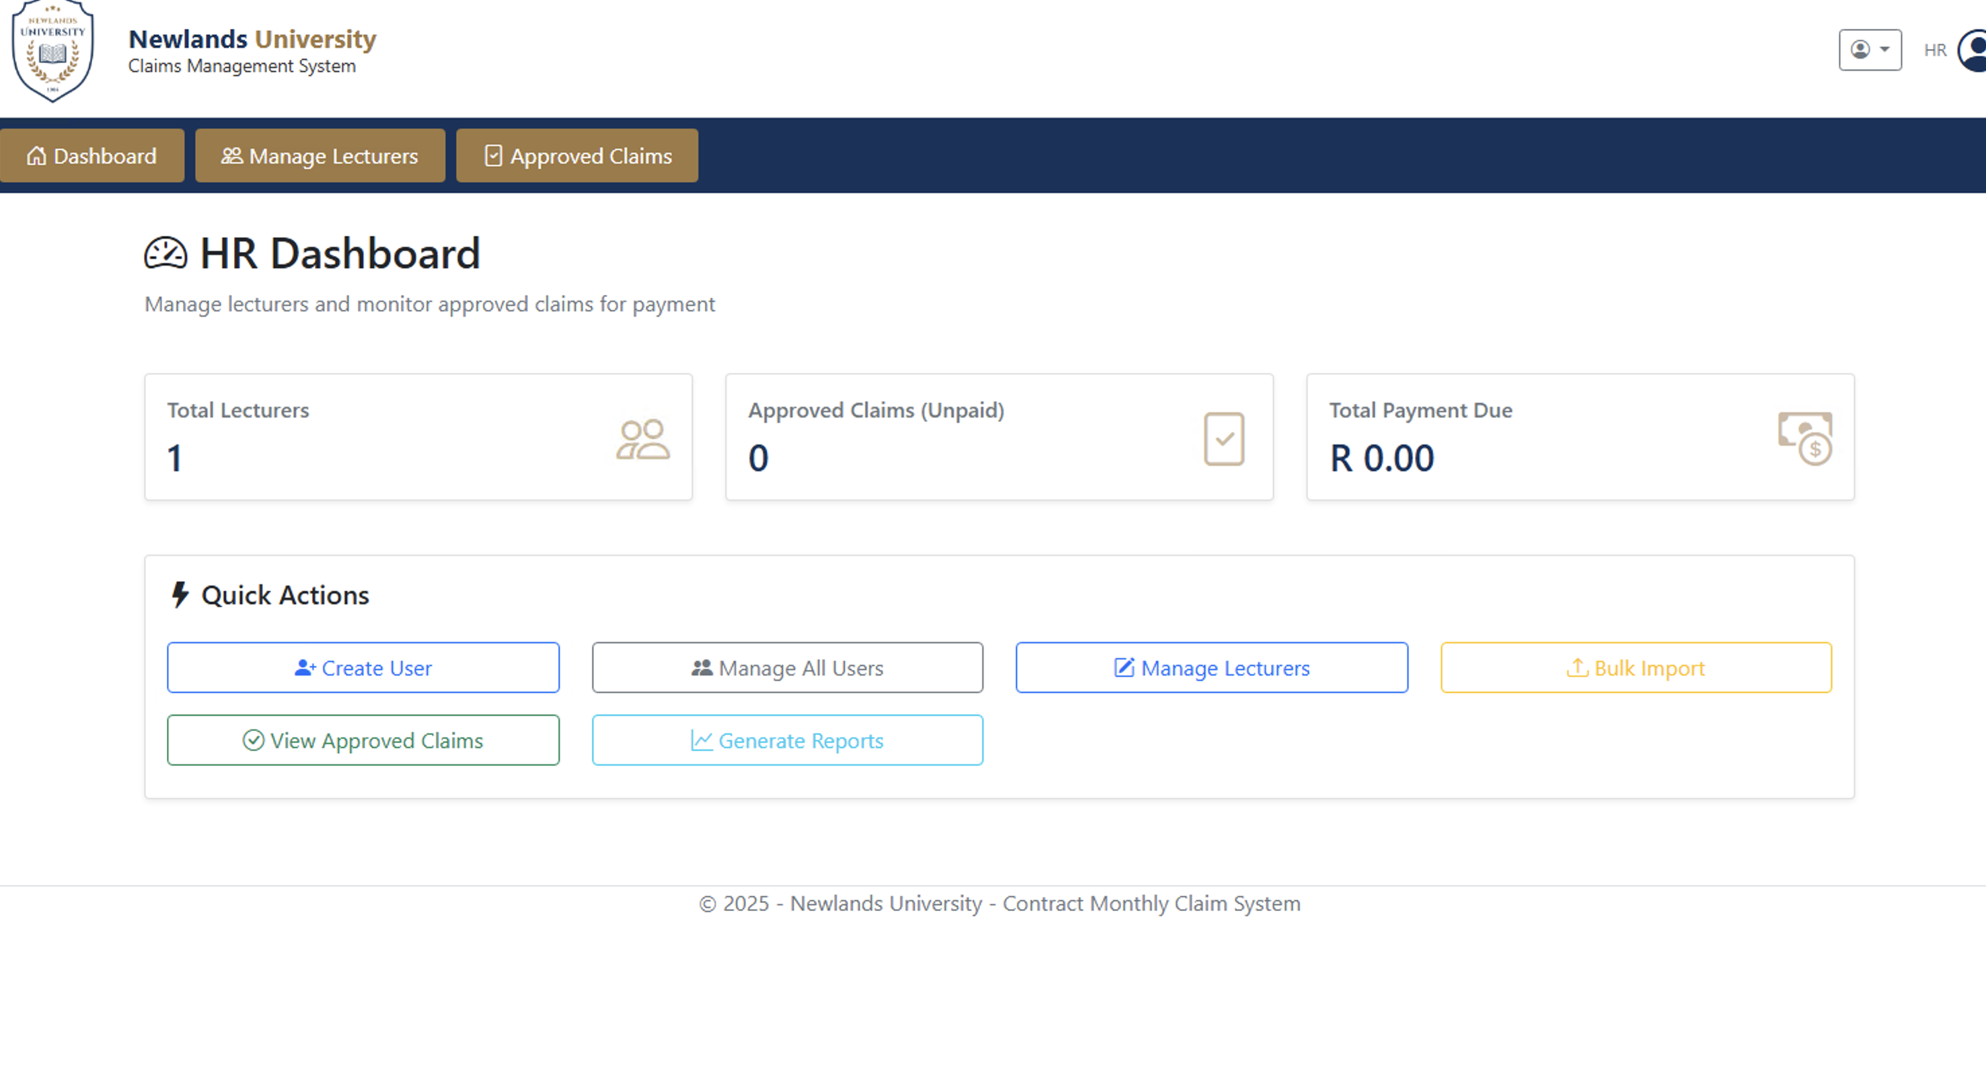
Part 3 – hr User management screenshot

Slide 14
Part 3 – HR Features (BULK UPLOADS)
Features Implemented
- Import multiple lecturers once via CSV file
Key Code (HRController.cs - GenerateInvoice)
public async Task<IActionResult> GenerateInvoice(Guid id)
{
var claim = await _context.Claims
.Include(c => c.Lecturer)
.FirstOrDefaultAsync(c => c.ClaimId == id);
// Only approved claims can generate invoices
if (claim.ClaimStatus != "Approved")
{
TempData["ErrorMessage"] = "Only approved claims can generate invoices";
return RedirectToAction(nameof(ApprovedClaims));
}
return View(claim); // Invoice view with payment details
}
Key Code (ExportReportCSV)
public async Task<IActionResult> ExportReportCSV()
{
var csv = new StringBuilder();
csv.AppendLine("Lecturer Name,Email,Hours,Rate,Total,Status");
foreach (var claim in approvedClaims)
{
csv.AppendLine($"{claim.Lecturer.Name},{claim.Lecturer.Email}," +
$"{claim.TotalHours},{claim.HourlyRate}," +
$"{claim.TotalHours * claim.HourlyRate},{claim.ClaimStatus}");
}
return File(Encoding.UTF8.GetBytes(csv.ToString()),
"text/csv", "ClaimReport.csv");
}

Slide 15
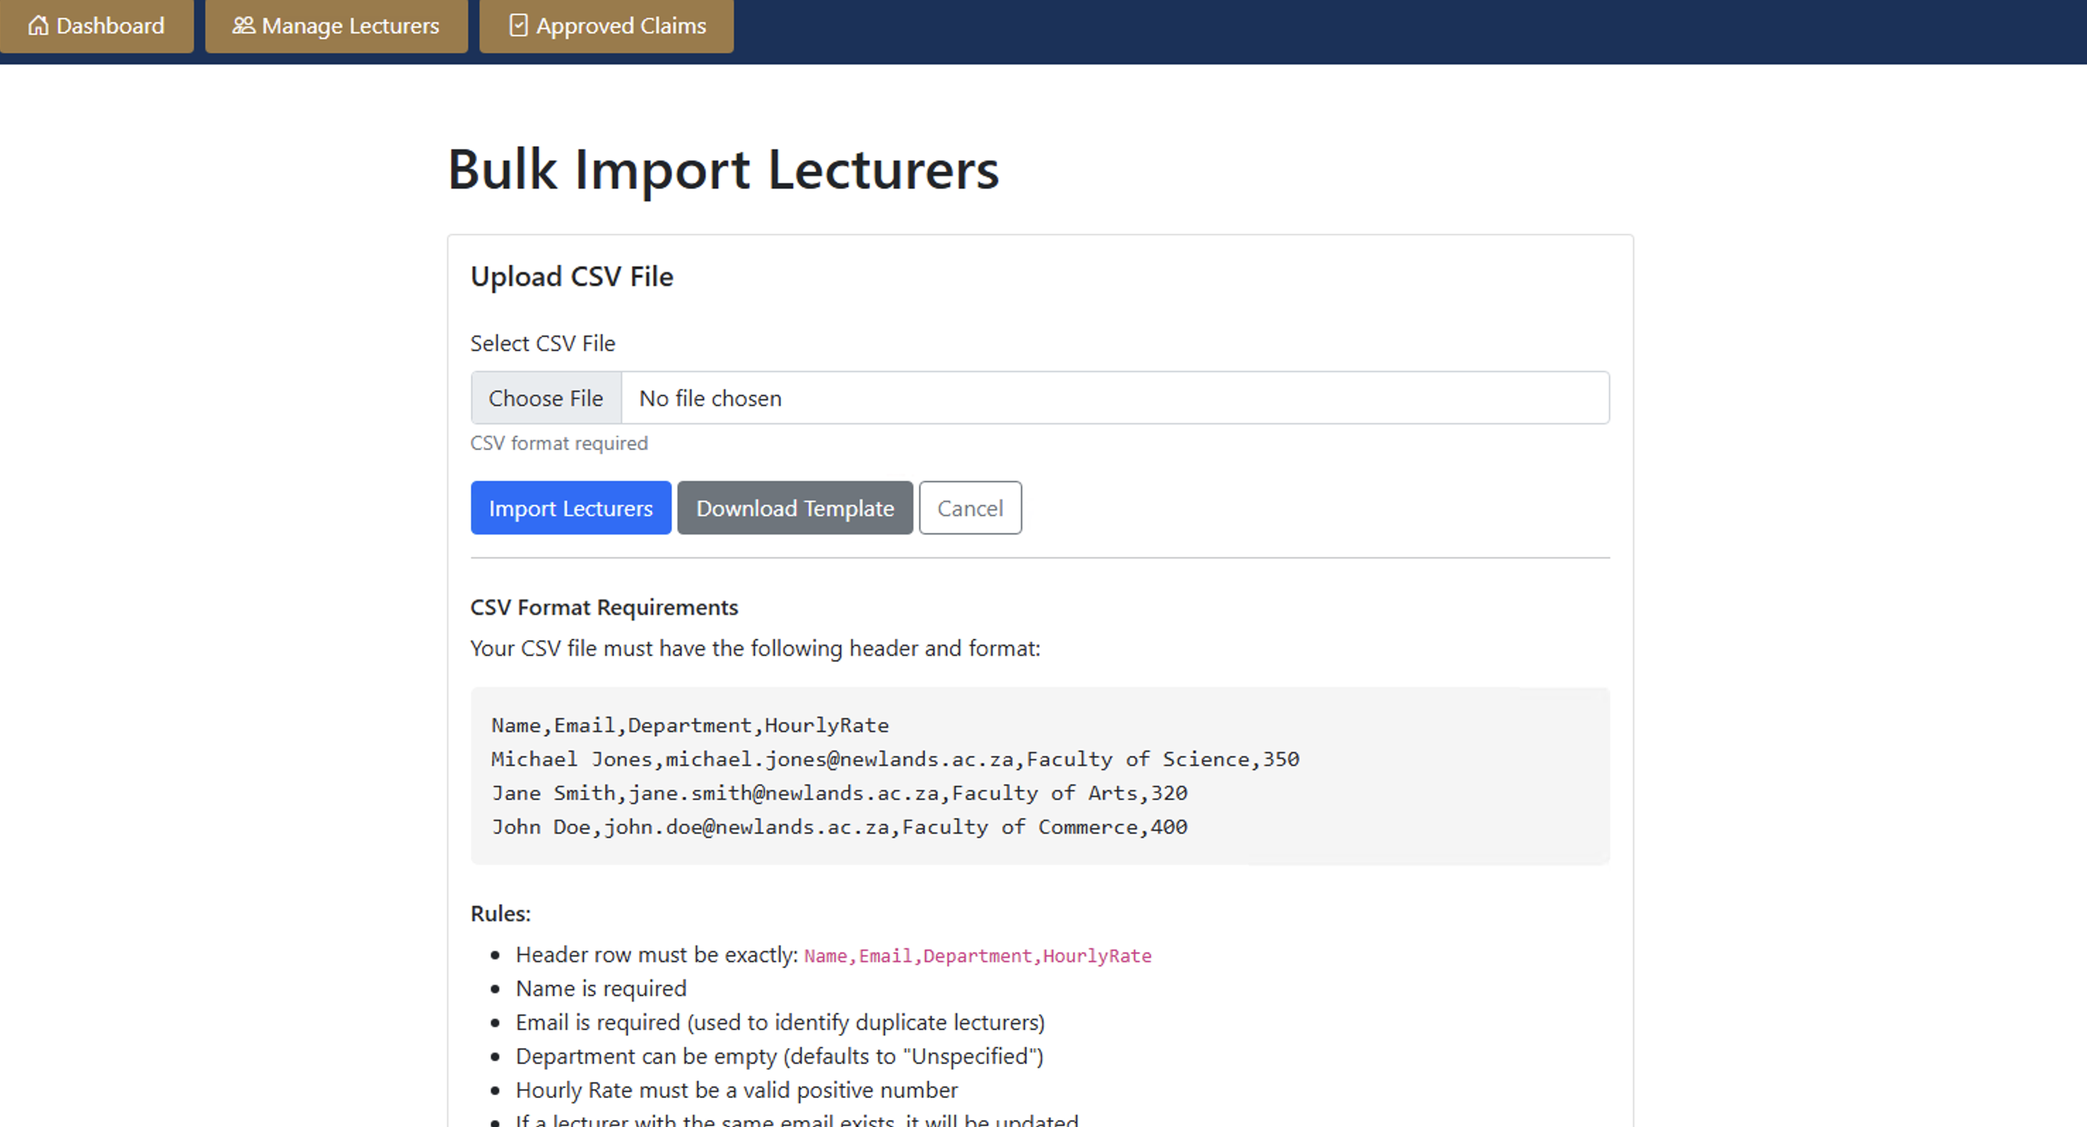
Part 3 – hr vIEWS AND FEATURES

Slide 16
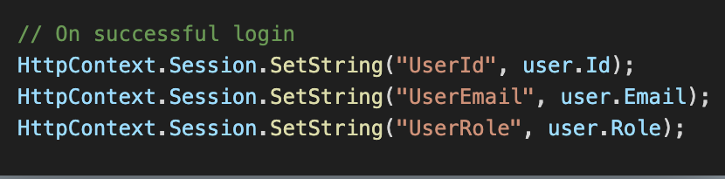
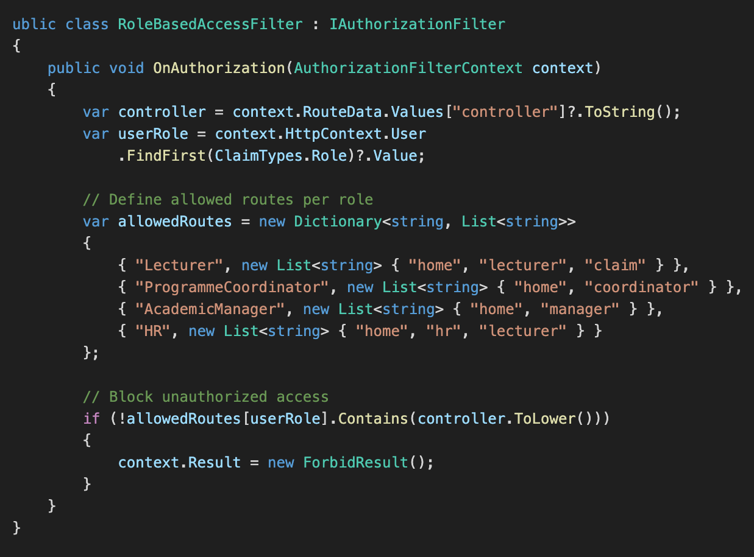
Part 3 – Session management & Access Control
Requirement
- Use sessions
- Users cannot access pages they're not supposed to
Key Code (RoleBasedAccessFilter.cs)
Key Code (AccountController.cs – Session Creation)

Slide 17
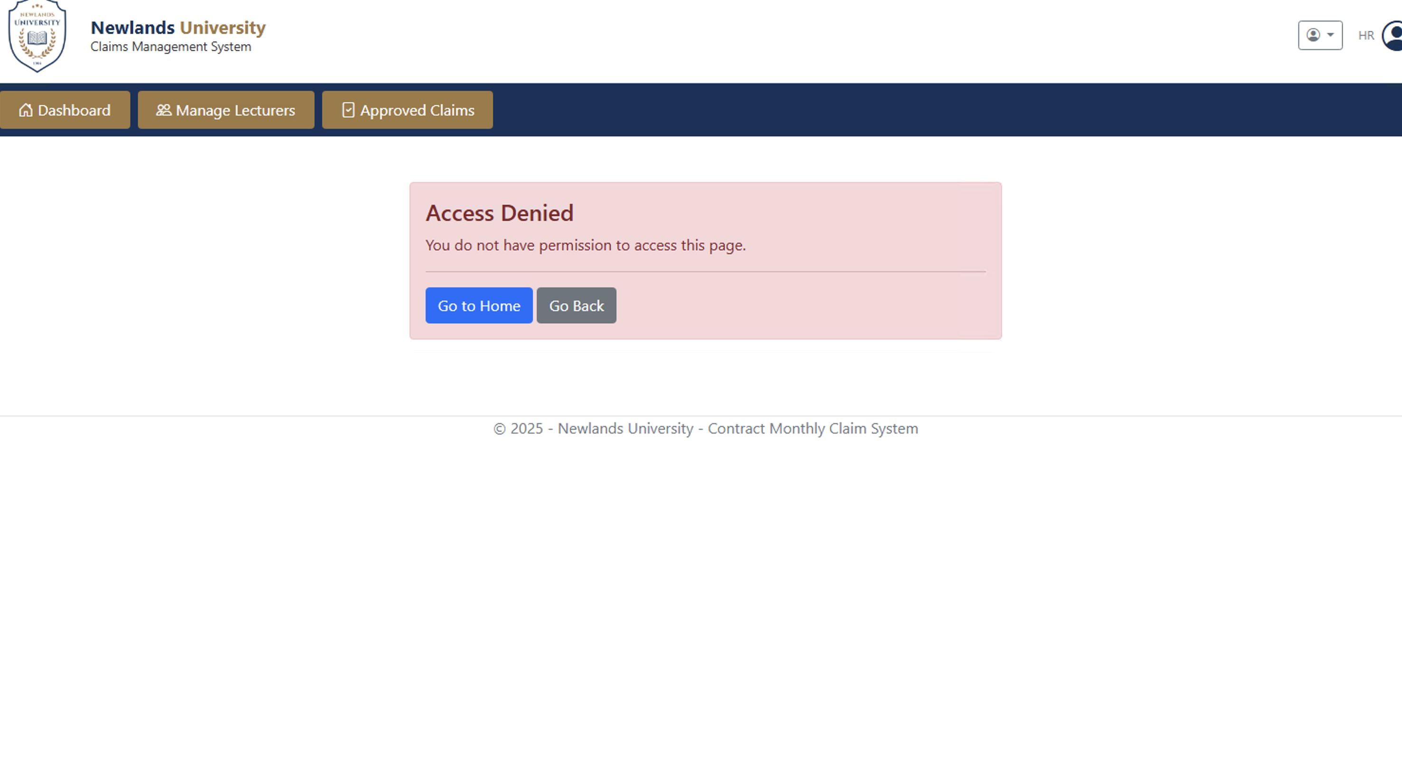
Part 3 – Session Management

Slide 18
technology STACK Overview
Component | Technology
Framework | ASP.NET Core 8.0 MVC
Database | SQL Server + Entity Framework Core
Authentication | ASP.NET Core Identity
Authorization | Role-based with custom filters
Session | HTTP Session middleware
Encryption | AES-256 (FIPS 140-2 compliant)
Validation | Data Annotations + IValidatableObject + FluentValidation
Reporting | LINQ + CSV export
Frontend | Bootstrap 5, jQuery

Slide 19
Security Features
Authentication - ASP.NET Core Identity with password hashing - Secure login/logout with session management | Authorization - Role-based access control (4 roles) - Custom authorization filter - Per-controller access restrictions
Data Protection - AES-256 encryption for documents - Input sanitization (XSS prevention) - SQL injection prevention via EF Core | Session Security - 30-minute idle timeout - HttpOnly cookies - IP address tracking

Slide 20
Demo Video

Slide 21
Conclusion
Part 3 Achievements - Full authentication with ASP.NET Core Identity - Role-based authorization (4 distinct roles) - Automated claim submission with locked hourly rates - Two-stage approval workflow - HR user and lecturer management - Invoice and report generation with CSV export - AES-256 document encryption - Circuit breaker error handling - Comprehensive validation system - Session management preventing unauthorized access | All Feedback Items Addressed - Feedback #1: Two-stage approval with modals - Feedback #2: Auto-fill hourly rate - Feedback #3: Document encryption (AES-256) - Feedback #4: Death loop prevention - Feedback #5: Real-time status tracking - Feedback #6: Enhanced error handling

Slide 22
Links
GitHub: https://github.com/VCCT-PROG6212-2025-G3/ST10440112-PROG6212-CCMS
YouTube: https://youtu.be/ibBrRa6oCKo

